Slide 1
Continuity of Operations Planning (COOP) Overview
Presenter: Kelly Boyd
Access and Functional Needs Planner
NJ Office of Emergency Management

Slide 2
What is COOP?
COOP = Continuity of Operations Planning
COOP is an effort to ensure the continued performance of essential functions during emergencies.

Slide 3
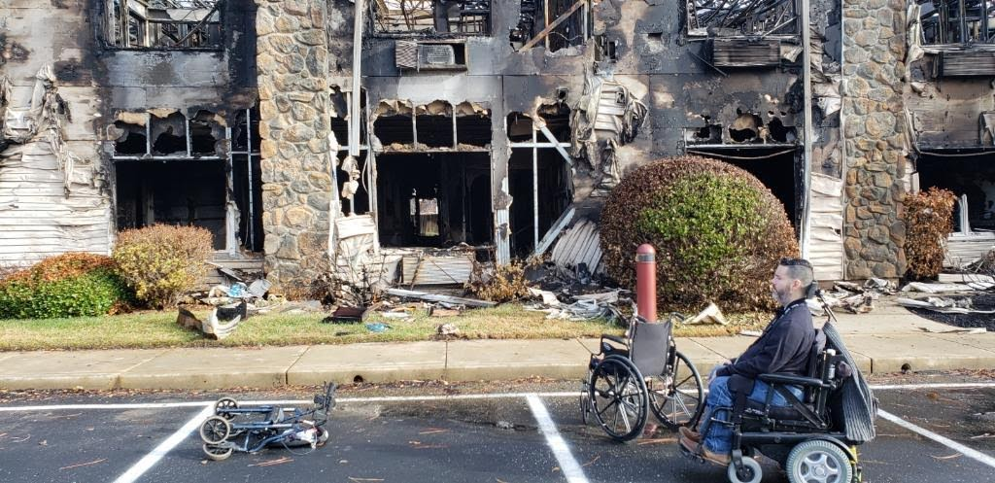
Reasons for COOP Activation
This area is vulnerable to numerous threats (large and small) that could interrupt normal operations.
Having a continuity (COOP) plan increases your ability to recover more quickly, easily, and efficiently.

Slide 4
What is COOP?
Aurora active shooter event.
COOP is different than an emergency plan, but they compliment each other.
COOPs address how a business is going to prioritize critical functions as well as continue services, deal with disruption, and restore the business.
Emergency plans are the specific actions, roles, and resources that a business will need in an emergency. This involves evacuation, communications, etc.

Slide 5
Reasons for COOP Activation
Conduct a hazard analysis to see what disasters could affect your business. These could be:
Fires
Floods
Earthquakes
Pandemics
Terrorism
Hurricanes/Severe Weather (snowstorms, heat waves, etc.)

Slide 6
Purpose of COOP Planning
Continue essential operations
Minimize business damage and losses
Allow for emergency delegation of authority and a line of succession
Safekeeping of essential records (personnel, resources, facilities, consumers, etc.)

Slide 7
Purpose of COOP Planning
Emergency acquisition of resources necessary for business resumption
Capability to perform critical functions remotely until resumption of normal operations
Achieve orderly response and recovery from incident

Slide 8
Leave on Friday…

Slide 9
…And Return on Monday
Destruction due to fire

Slide 10
Critical Questions
If disaster struck:
Could you operate without your theater?
What impact would your inability to continue operations have on those you serve?

Slide 11
COOP Recommendations
Plans should be able to:
Be implemented anytime—with or without warning.
Provide full operational capability for essential functions no later than 12 hours after activation.
Sustain essential functions for up to 30 days or until normal operations can be resumed.

Slide 12
COOP Recommendations
Appoint a COOP Planning Coordinator to:
Develop, approve, and maintain the COOP plan.
Coordinate with the planning team.
Oversee tests, training, and exercises as well as corrective action planning and long-term planning efforts.

Slide 13
Continuity Planning Team
Continuity Planning Team members should be:
Selected based on their expertise in specific areas related to the essential functions.
Assigned specific portions of the continuity plan to research and develop.
Able to work collaboratively with other team members.

Slide 14
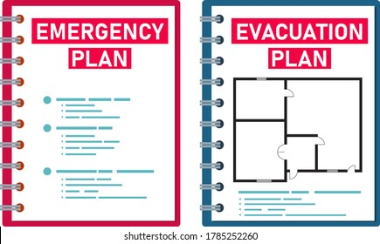
Essential Elements of COOP
Plans & Procedures
Mission Essential Functions
Delegations of Authority
Orders of Succession
Alternate Sites
Interoperable Communications

Slide 15
Essential Elements of COOP
Vital Records and Databases
Logistics and Administration
Personnel Issues and Coordination
Security
Testing, Training, and Exercises
Program Management

Slide 16
Plans & Procedures
Plans provide:
guidance on operations
phases of activation and implementation
a list of authorities and alternates

Slide 17
Plans & Procedures
Plans provide:
alert and notification procedures
lists of alternate sites to use during emergencies
MOUs should be included

Slide 18
Mission Essential Functions
Mission Essential Functions (MEFs) include functions that:
need to be resumed within 30 days
impact external or internal customers
impact services/operations

Slide 19
Mission Essential Functions
Examples include functions that involve:
enable hiring of employees
grant management
requirements by regulation/statutes
payroll
miscellaneous

Slide 20
Mission Essential Functions
Action steps:
List all organizational functions
Identify mission essential functions
Assign qualified personnel to complete those functions
Determine required resources and equipment
Assess alternate site against needs of mission essential functions

Slide 21
Delegations of Authority
Determine which employees are essential and needed during emergencies.
This group will comprise the Emergency Response Group (ERG).
They will operate from the alternate site or work from home, as warranted.
Establish succession for key leadership positions.
Outline roles/identify to whom authorities should be delegated.

Slide 22
Delegations of Authority
Delegations of authority have several purposes:
Approving emergency policy changes
Approving changes of Standard Operating Procedures
Empowering designee(s) to act on behalf of theater in interagency response
Making personnel management decisions
Approving commitment of resources
Signing contracts and authorizing procurement

Slide 23
Orders of Succession
Orders of Succession are different than Delegations of Authority. They:
Establish rules and procedures addressing conditions of succession, as well as methods of notification.
Identify limitations on delegated authority.

Slide 24
Alternate Sites
When looking for sites to relocate operations to, keep in mind that they must:
Provide for reliable logistical support services and infrastructure systems
Be able to sustain operations for 30 days
Provide for appropriate physical security and access controls
NOTE: Establish any necessary Memorandums of Agreement (MOAs)/Memorandums of Understanding (MOUs) and partner agreements in advance. Also, consider pre-positioning assets and resources at the site.

Slide 25
Interoperable Communications
Determine what data and communication systems are needed (telephone, fax, email, data, etc.)
Ensure availability at alternate site (voice, fax, email, data, etc.)

Slide 26
Vital Records and Databases
Identify vital records (hard copy and electronic) needed to support essential functions.
Examples of vital records include emergency operating records, legal/financial records, and consumer records.

Slide 27
Vital Records and Databases
Emergency operating records include:
Emergency Operation Plans
Standard Operating Procedures
Orders of Succession
Delegations of Authority
Contact Information

Slide 28
Vital Records and Databases
Legal and financial records may include:
Personnel Records
Social Security Records
Payroll Records
Retirement Records
Insurance Records
Contract Records

Slide 29
Vital Records and Databases
Plan for protection, duplication/back up, and movement of records
Preposition resources and systems prior to COOP deployment

Slide 30
Logistics and Administration
Identify, pre-position, and maintain equipment and resources required at an alternate site.
Prepare for telecommunication and data support at an alternate site.
Prepare and maintain site support procedures, which identify the initial requirements for receiving, supporting, and relocating personnel to an alternate site.

Slide 31
Logistics and Administration
Prepare and pre-position drive away kits.
These kits contain essential equipment, reference material, and supplies needed to perform essential functions.

Slide 32
Logistics and Administration
Items to include in drive away kits are:
COOP documents
Current Internal/External contact lists (phone, e-mail, fax, etc.)
Flash drives with computer files
General office supplies (small amount)
Cell phones
Current equipment report
Current software report
Other

Slide 33
Personnel Issues & Coordination
Prepare communications plan to disseminate information.
Employees must have a clear understanding of what they are supposed to do in an emergency.
Address health and safety of employees and their families.
Implement necessary policies.
Ensure payroll procedures are in place.

Slide 34
Personnel Issues & Coordination
Identify and provide necessary accommodations and modifications to employees with disabilities or medical needs.
Provide consumers with assistance as needed, such as credits.

Slide 35
Security
Establish Operational Security (Information Control) and Cyber Guidelines for handling of plans.
Address security of current and alternate site.
Be prepared to augment all security levels based on the emergency or threat.

Slide 36
Testing, Training, and Exercises
Creating a Testing, Training, and Exercise Program ensures that:
Essential functions are supported.
All equipment and systems work as required.
Timeliness of deployment is appropriate.
Continuity of supplies and capabilities are adequate at the site.

Slide 37
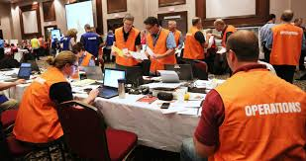
Testing, Training, and Exercises
Employees understand their roles.
Interdependencies, supply chain issues, and infrastructure capabilities are addressed.
Deficiencies and vulnerabilities are identified and addressed.

Slide 38
Testing, Training, and Exercises
Make sure to:
Conduct training for identified COOP personnel.
Test alert and notification procedures.
Plan periodic exercises of plans.
Try out alternate sites and test interoperable communications.
Update plans and procedures annually or as needed.

Slide 39
Program Management
Establish a COOP management process to ensure plan:
maintenance
efficiency
funding

Slide 40
Checklists
To help with the COOP process, checklists for the following may be used:
Staff responsibilities
Emergency supplies
Drive Away Kits
*Samples of these checklists and others can be found online.

Slide 41
Completion of COOP Draft
After creating your COOP:
Review entire draft for accuracy.
Provide copies to all employees with their roles.
Establish training and exercise schedule.
Ask your local OEM or an emergency management specialist to review it.

Slide 42
Resources
FEMA’s Independent Study COOP Course:
FEMA - Emergency Management Institute (EMI) Course | IS-1300: Introduction to Continuity of Operations
www.continuitycentral.com
Business Continuity Checklist | Business Continuity Planning Checklist (disasterrecoveryplantemplate.org)
www.ready.gov
www.continuityinsights.com

Slide 43
QUESTIONS OR COMMENTS?
Contact:
Kelly Boyd
(609) 455-9068
kelly.boyd@njsp.gov

