Slide 1
Responding to Individuals with Disabilities and
Access and Functional Needs During Active Shooter Events
Presenter: Kelly Boyd
Access and Functional Needs Planner
NJ Office of Emergency Management

Slide 2
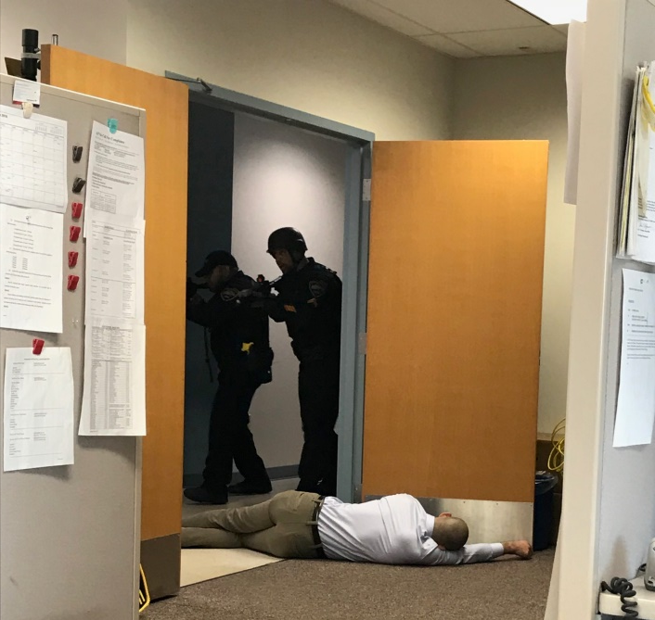
Workshop Overview
The Disabilities and Access and Functional Needs (DAFN) community is often overlooked during active shooter events or other violent situations.
Active shooter events and similar emergencies are high stress situations that can be complex and change rapidly—impacting all involved.
Emergency plans for theaters, schools, office buildings, and other facilities are often basic and rarely address special considerations pertaining to individuals with DAFN.

Slide 3
Workshop Overview
Since there is no established best practice on how to respond to people who have DAFN during an active shooter situation, this workshop provides information on what to expect during active shooter events, recommended actions, and how to communicate effectively with individuals who have disabilities and access and functional needs (DAFN).

Slide 4
What is a Disability?
Americans with Disabilities Act definition:
An individual with a disability is a person who has a physical or
mental impairment that substantially limits one or more major life
activities.
Notes:
Passed in 1990, the ADA is the most comprehensive civil rights law for disabled people in the United States. The ADA definition of disability is quite broad. In fact, it is estimated that nearly 1 in 5 people in the United States are disabled-
Approximately 1.75 million New Jerseyans - have a disability that may limit their physical or cognitive function.
As such, people with disabilities constitute the single largest minority group in the U.S., surpassing all other demographic groups.
People with disabilities tend to be poorer, less educated, and less employed than their non-disabled peers. Consider, for example, it is estimated that nearly 70% of people with disabilities are unemployed.

Slide 5
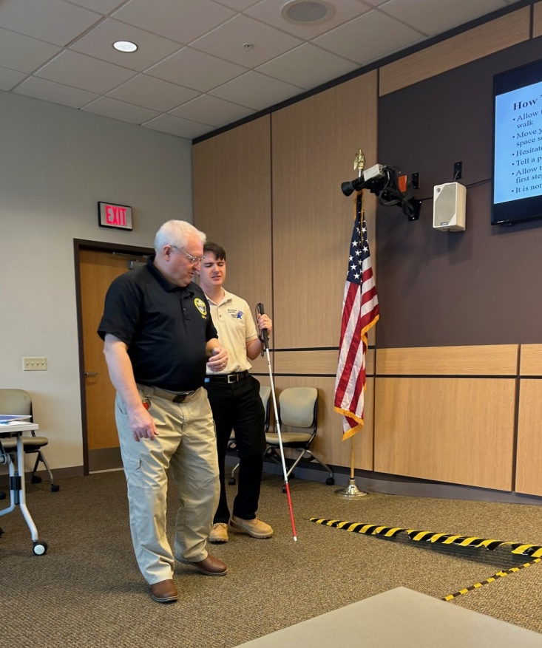
Major Life Activities
Self-care
Receptive and expressive language
Learning
Mobility
Self-direction
Capacity for independent living
Economic self-sufficiency
Notes:
Self care- bathing, toileting, dressing, eating etc.
Receptive and expressive language- “Receptive and expressive language skills develop from infancy. Receptive language skills, the ability to take in language and understand, include being able to follow directions, understand a story, and understand figurative language. Expressive language skills encompass the many ways of conveying a message. Expressive language skills include learning the forms of language”
Learning- the ability to acquire, understand and use information in a meaningful way
Mobility- activities requiring voluntary movement like walking, sitting etc.
Self-direction- the ability for an individual to make their own decisions and manage their daily lives effectively, with or without the help of an assistant
Capacity to live independently- an individual can live independently without a guardian to manage their daily affairs.
Economic self-sufficiency- the capacity to work-this is not to be confused with the availability of work in a particular area.
Source:
http://www.communication.northwestern.edu/clinics/speech_language/expressive_language/

Slide 6
Types of Disabilities
Intellectual/Developmental disabilities (I/DD)
Physical disabilities
Psychiatric disabilities
Hearing disabilities
Visual disabilities
Invisible disabilities
Other sensory disabilities
Chronic conditions
Notes:
There are many types of disabilities. Some are visible, but most are not. It is also possible that an individual may have more than one type disability.
Some statistics for non-institutionalized adults 18 years and older:
Number of adults with hearing trouble: 37.6 million
Percent of adults with hearing trouble: 16.0%
Number of adults with vision trouble: 20.6 million
Percent of adults with vision trouble: 8.8%
Number of adults unable (or very difficult) to walk a quarter mile: 17.2 million
Percent of adults unable (or very difficult) to walk a quarter mile: 7.3%
Number of adults with any physical functioning difficulty: 35.2 million
Percent of adults with any physical functioning difficulty: 15.0%
Source: Summary Health Statistics for U.S. Adults: National Health Interview Survey, 2012, tables 11, 12, 18, 19 [PDF - 1.3 MB]
Number of adults with at least one basic actions difficulty or complex activity limitation: 74.6 million (2011)
Percent of adults with at least one basic actions difficulty or complex activity limitation: 32.9% (2011)
Source: Health, United States, 2012, table 48 [PDF - 9.8 MB]
Non-institutionalized adults 65 years and older
Percent of adults 65-74 years who need help with personal care from other persons: 3.3%
Percent of adults 75 years and over who need help with personal care from other persons: 10.5%
Source: Summary Health Statistics for the U.S. Population: National Health Interview Survey, 2012, table 5 [PDF - 1 MB]
Number of adults 65 years and older with at least one basic actions difficulty or complex activity limitation: 23.7 million (2011)
Percent of adults 65 years and older with at least one basic actions difficulty or complex activity limitation: 62.0% (2011)
Source: Health, United States, 2012, table 48 [PDF - 9.8 MB]”
As you can see by these statistics, disabilities aren't as uncommon as one may think

Slide 7
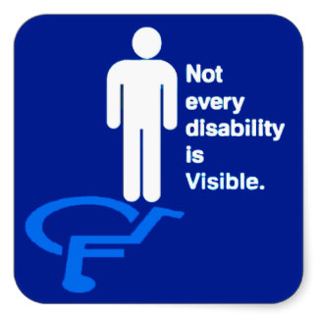
Access and Functional Needs
Access and Functional Needs (AFN) is a function-based definition of disability. Instead of using the term "special needs,” AFN reflects the capabilities of the individual—not the condition, label or medical diagnosis.
Source: www.ready.nj.gov/plan/special-needs.html
Notes:
This applies to ALL people with disabilities including those with behavioral health diagnoses
Or more completely- access and functional needs are: those actions, services, accommodations, and programmatic, architectural, and communication modifications that a covered entity must undertake or provide to afford individuals with disabilities a full and equal opportunity to use and enjoy programs, services, activities, goods, facilities, privileges, advantages, and accommodations in the most integrated setting, in light of the exigent circumstances of the emergency and the legal obligation to undertake advance planning and prepare to meet the disability-related needs of individuals who have disabilities as defined by the ADA Amendments Act of 2008, P.L. 110-325, and those associated with them.

Slide 9
DAFN & CMIST
Individuals with DAFN have issues regarding CMIST:
Communication - Individuals who have limitations that interfere with the receipt of and response to information will need that information provided in accessible formats they can understand and use. They may not be able to hear verbal announcements, see directional signs, or understand how to get assistance due to hearing, vision, speech, cognitive, or intellectual limitations, and/or limited English proficiency. This support may include interpreters, translators, hearing aids, message boards, electronic devices and 508 compliant websites that are accessible to all users.
Maintaining Health - Individuals who are not self-sufficient or who do not have adequate support from caregivers, family, or friends may need assistance with: managing unstable, terminal or contagious conditions that require observation and ongoing treatment; managing intravenous therapy, tube feeding and vital signs; receiving dialysis, oxygen and suction administration; managing wounds; and operating power dependent equipment to sustain life. These individuals require the support of trained medical professionals.

Slide 10
DAFN & CMIST
Independence - Individuals requiring support to be independent in daily activities may lose this support during an emergency or a disaster. This support may include supplies, durable medical equipment, and attendants or caregivers.
Support, Safety and Self-determination- Before, during, and after an emergency, individuals may lose the support of caregivers, family, or friends and/or may be unable to cope in a new environment (particularly if they have autism, dementia, Alzheimer’s or psychiatric conditions, such as schizophrenia or intense anxiety). If separated from their caregivers, young children may be unable to identify themselves; and when in danger, they may lack the cognitive ability to assess the situation and react appropriately.
Transportation - Individuals who cannot drive or who do not have a vehicle may require transportation support for successful evacuation. This support may include accessible vehicles (e.g., vehicles that are lift-equipped or suitable for transporting individuals who use oxygen) or information about how and where to access mass transportation during an evacuation.

Slide 11
DAFN Active Shooter Video
This video was created by Union County several years ago. It provides an overview of how to respond to an active shooter situation involving people with DAFN.
Active Shooter Prep v4 final w:captions:New Title.mp4 - Google Drive

Slide 12
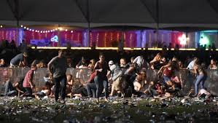
Areas to Consider in Plans
Schools
Malls
Hospitals
Medical facilities
Grocery stores
Arenas
Amusement parks
Concert halls
Community events
Shooting at the Route 91 Harvest Festival in Las Vegas

Slide 13
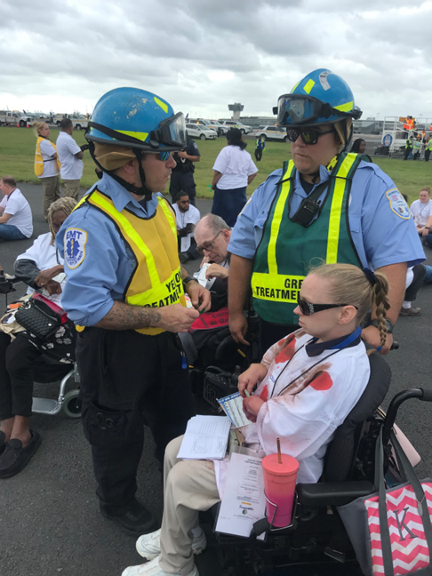
Types of Disabilities and How to Respond
There is no right or wrong way to respond! Use your best judgement. The following slides offer tips on how best to assist people with various disabilities and access and functional needs during active shooter incidents.

Slide 14
Types of Disabilities and How to Respond
The following tips were provided by Adrienne Robertiello, Chair of the Union County Core Advisory Group. She is also a member of the group’s DAFN Active Shooter Subcommittee.
Ms. Robertiello has a son who has autism and works as a Specialized Health Care Educator at Children’s Specialized Hospital.
*NJOEM’s AFN Planner also contributed to the following recommendations.

Slide 15
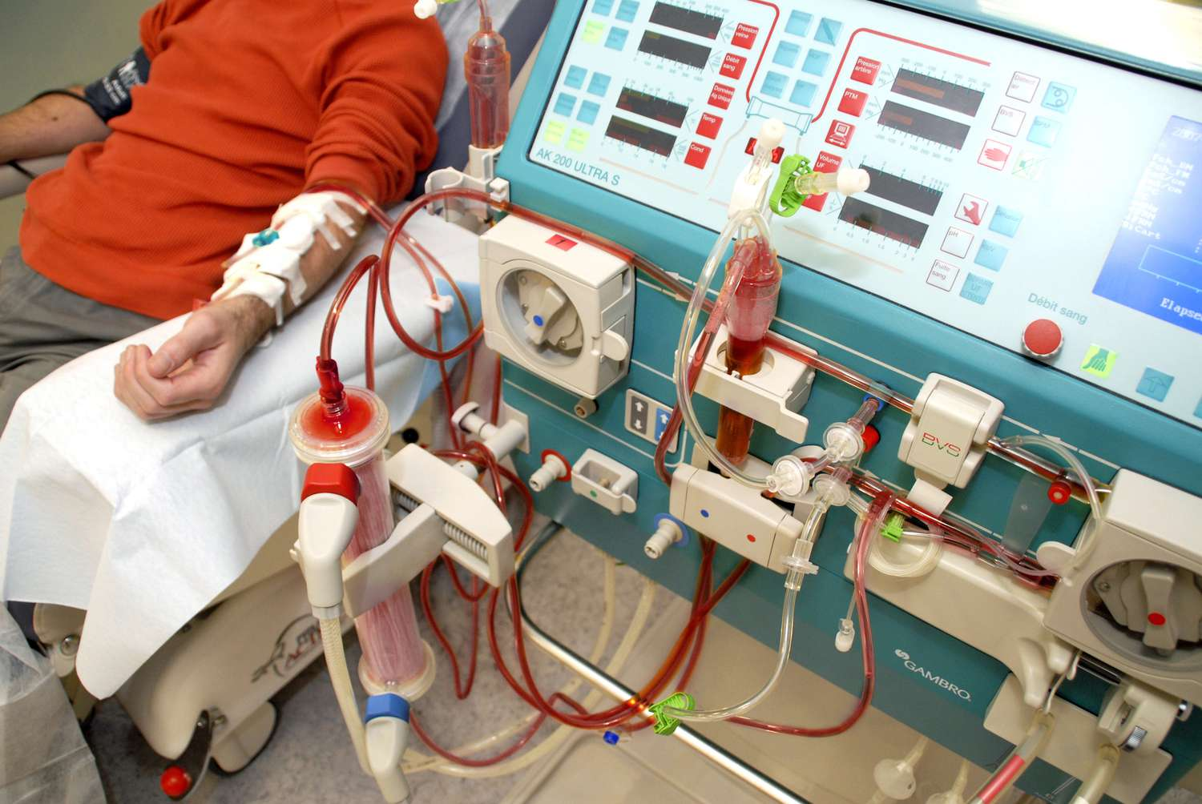
Issues to Consider
Some office doors don’t lock.
People may not be able to push a bookshelf in front of a door to secure it.
Dialysis issue: Patients are hooked up to a complex machine for treatment and often forget how to disconnect or simply can’t. Staff have been told to save themselves, which can cause emotional conflict.

Slide 16
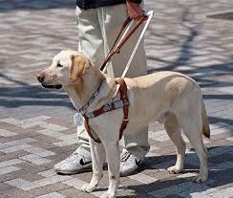
Vision Loss or Blind

Slide 17
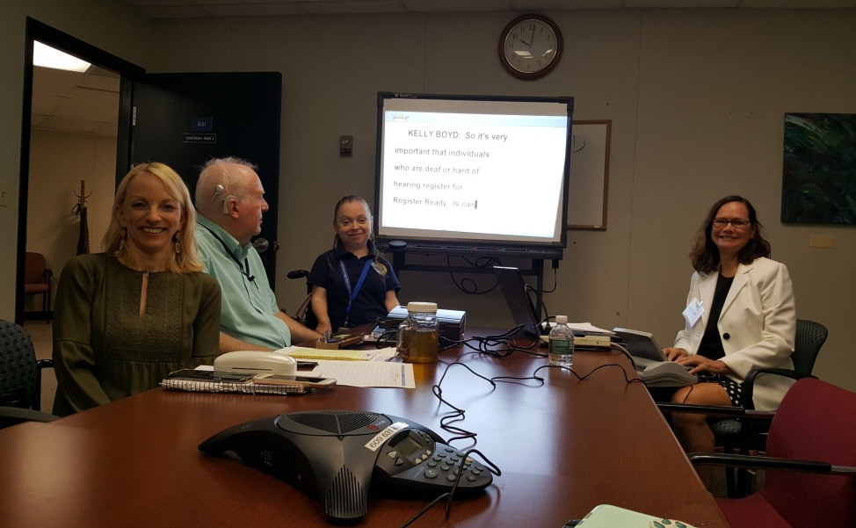
Hearing Loss or Deaf

Slide 18
Mental Health Conditions

Slide 19
Autism Spectrum Disorder
Those with autism can be significantly affected due to sensory, communication, and processing differences.
Concerns during an active shooter situation:
Sensitivity to loud noises, bright lights, unfamiliar environments and expectations can lead to sensory overload and distress
May have difficulty understanding and reacting to rapidly changing activity; may experience anxiety from changes in routine or environment and urgency of the scenario
May be more vulnerable to manipulation of active shooters
May not be able to comprehend the seriousness of the situation
May have limited receptive and/or expressive verbal communication or may communicate in alternate methods
May not be able to express needs or understand instructions, particularly those that are complex
May be mistaken for the active shooter due to certain behaviors or not responding appropriately
May elope or wander due to distress, confusion, or anxiety; may try to escape without recognizing the dangers

Slide 20
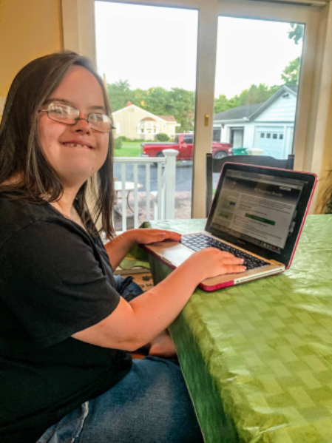
Intellectual Disability

Slide 21
Acquired Brain Injury

Slide 22
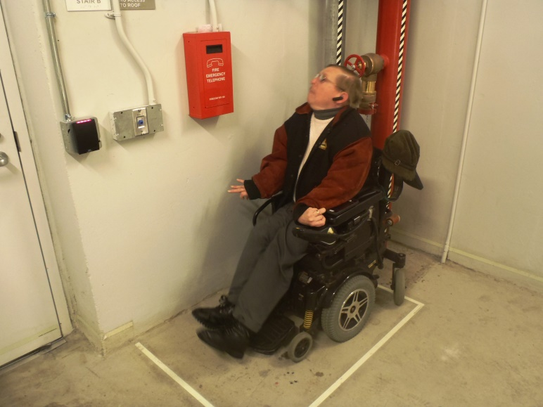
Physical Disability

Slide 23
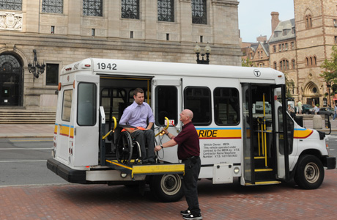
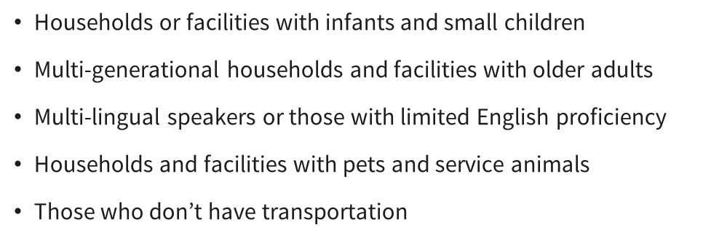
Other AFN

Slide 24
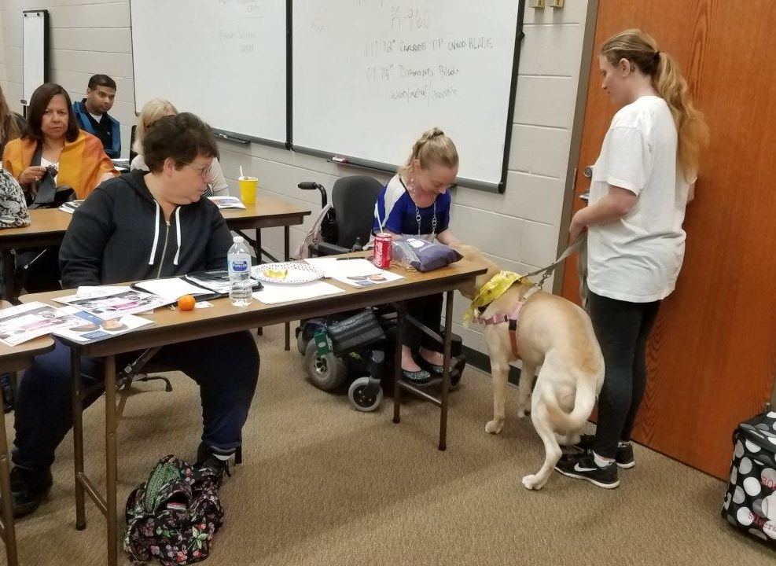
Assisting During the Aftermath
Bring in Disaster Response Crisis Counselors.
New Jersey was one of the first states in the nation to undergo a formal process for certification of its disaster crisis response workforce. The NJDRCC certification represents a partnership between the New Jersey Division of Mental Health and Addiction Services' Disaster and Terrorism Branch, the Mental Health Association of New Jersey, and The Certification Board of New Jersey, Inc.
Individuals are trained and provide a coordinated and integrated response to disasters and traumatic events in the community.
Crisis Response Canines deploys certified Animal Assisted Therapy (AAT) and Animal Assisted Crisis Response (AACR) teams to traumatic events when needed. For details, visit:
Home | Crisis Response Canines (crisiscanines.org)

Slide 25
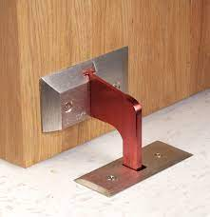
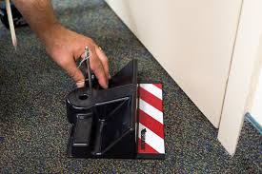
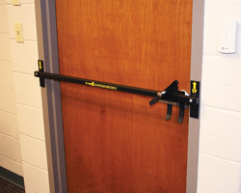
Recommendations
Make sure windows have shades and doors have locks.
Consider special door security devices or door stops.
Staff should help patrons with DAFN maintain situational awareness in the theater. It is important to point out:
Exits (note if they have steps or ramps)
Alarms
Evacuation instructions/posters

Slide 26
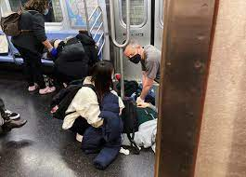
Recommendations
Emergency managers in New Jersey have conducted active shooter drills in New Jersey at long-term care facilities, malls, train stations, and so forth.
NJ Transit conducts annual drills at various sites (they rotate) and focus on DAFN. Their active shooter drills are very enlightening!
Lessons learned: Individuals who are deaf didn’t know what was going on. They couldn’t hear gun shots or directions and didn’t know what to do or where to run. People who use wheelchairs and walkers were mostly stuck on the train and the outcome was grim.
We recommend conducting an active shooter drill at theaters across New Jersey.
Include people with various types of DAFN.
If you conduct a drill(s), please let us know how it went. We like to hear about lessons learned.

Slide 27
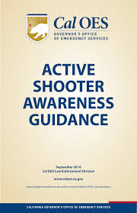
Resources
Cal OES Governor’s Office of Emergency Services Active Shooter Awareness Guidance
http://www.caloes.ca.gov/Cal-OES-Divisions/Access-Functional-Needs
A PowerPoint presentation is also available online.

Slide 28
QUESTIONS OR COMMENTS?
Contact:
Kelly Boyd
(609) 455-9068
kelly.boyd@njsp.gov

